Slide 1
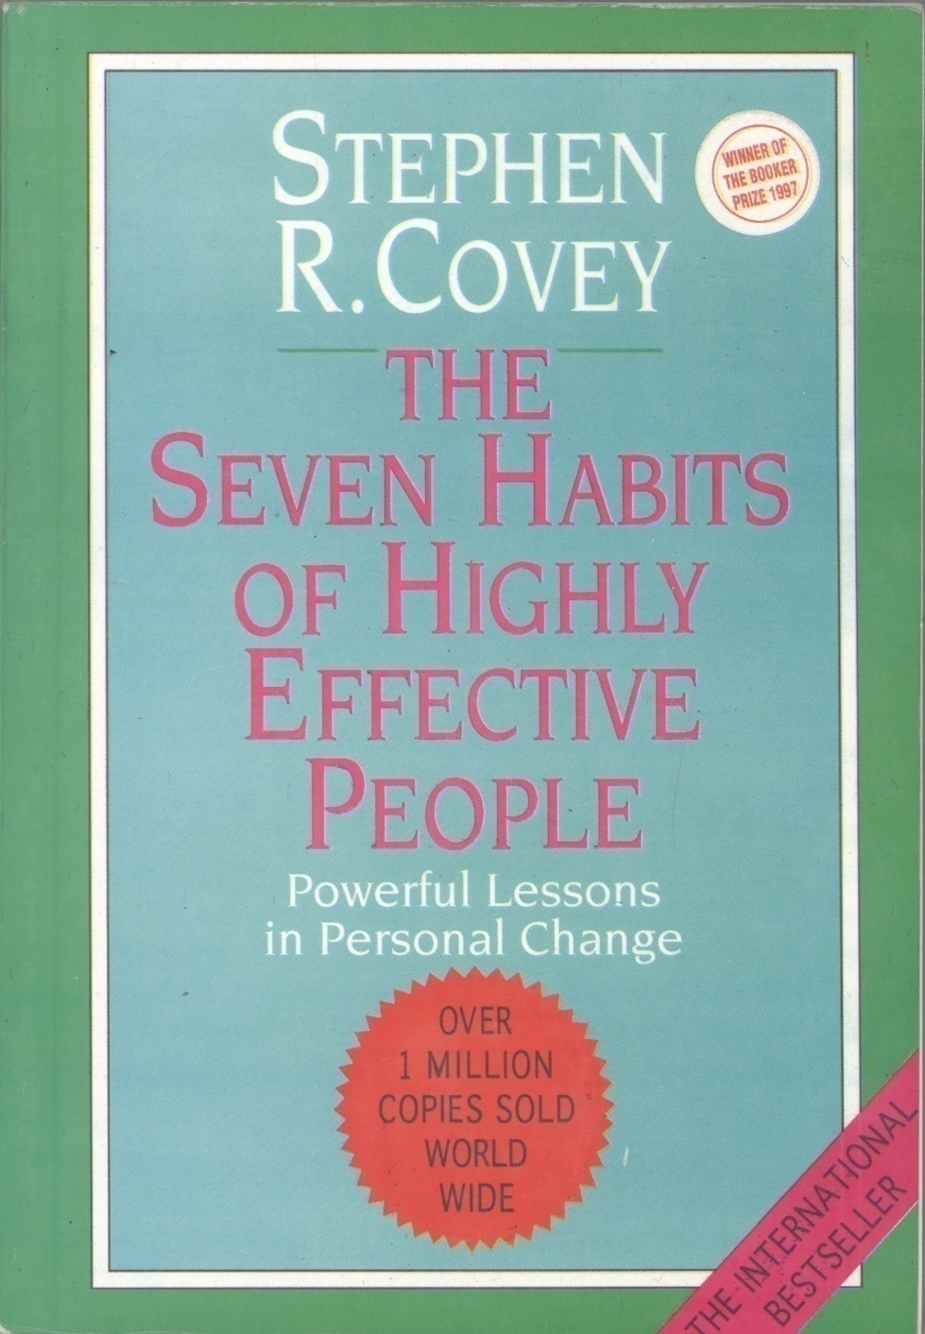
The
Seven Habits of Highly Effective People
Stephen Covey

Slide 2
Contents
Part One: PARADIGMS AND PRINCIPLES
Inside Out
The Seven Habits – An Overview
Part Two: PRIVATE VICTORIES
Habit 1: 'Be Proactive'
Habit 2: 'Begin with the End in Mind'
Habit 3: 'Put First Things First'

Slide 3
Contents (continued)
Part Three: PUBLIC VICTORY
Paradigms of Interdependence
Habit 4: 'Think Win/Win'
Habit 5: 'Seek First to Understand, Then to Be Understood'
Habit 6: 'Synergize'
Part Four: RENEWAL
Habit 7: 'Sharpen the Saw'
Inside-Out Again

Slide 4
PART 1
PART 2
PART 3
PART 4
PART ONE
PARADIGMS AND PRINCIPLES

Slide 5
- Inside Out
Problems
The Personality and Character Ethics
Primary and Secondary Greatness
The Power of a Paradigm
The Power of a Paradigm Shift

Slide 6
What Do You See?

Slide 7
Now?

Slide 8
- Inside Out (continued)
Seeing and Being
Principle-Centered Paradigm
The Way We See the Problem is The Problem
A New Level of Thinking

Slide 9
- The Seven Habits – An Overview
Habits Defined
The Maturity Continuum
Effectiveness Defined
P/PC Balance
Goose and the Golden Egg
Three Kinds of Assets
How to Use This Book
What You Can Expect
Knowledge (what to, why to)
Desire (want to)
HABITS
Skills (how to)

Slide 10
The Seven Habits Paradigm

Slide 12
PART 1
PART 2
PART 3
PART 4
PART TWO
PRIVATE VICTORY

Slide 13
- Habit 1: Be Proactive
Self awareness
Social Mirror – The crazy mirror room!
Determinism
Genetic
Psychic
Environmental
Stimulus
Response

Slide 14
- Habit 1: Be Proactive (continued)
The Proactive Model
Freedom to Choose
Self-Awareness
Imagination
Conscience
Independent Will
Proactivity Defined
Freedom To Choose
Stimulus
Response
Self Awareness
Independent Will
Imagination
Conscience

Slide 15
- Habit 1: Be Proactive (continued)
Taking the Initiative
Act or Be Acted Upon
Listening To Our Language
Have To vs. Prefer To
I must vs. I Prefer
Circle of Concern/Circle of Influence
No Concern
Circle of Concern

Slide 16
Proactivity Leads from (A) To (B)
Circle of
Circle of Concern
Circle of Influence
Circle of Influence
Concern
(A)
(B)

Slide 17
- Habit 1: Be Proactive (continued)
Reactive Focus
Direct, Indirect, and No Control
Expanding the Circle of Influence
The “Have’s” and the “Be’s”
The Other End of The Stick
Making and Keeping Commitments
Proactivity: The Thirty-Day Test
Circle of Concern
Circle of Influence
Reactive Focus

Slide 18
- Habit 2: Begin With The End In Mind
Scenario Imagining
Know your desired destination
Ladder against the right wall!
All things are created twice
By design or by default
The difference between Leadership and Management
Our own script: our Personal Mission Statement

Slide 19
- Habit 2: Begin With The End In Mind
Begin at the center
Security
Guidance
Wisdom
Power
Alternative Centres
Family
Money
Work
Possession
Pleasure
Friend/Enemy
Self
Security
Wisdom
Guidance
CENTER
Power

Slide 20
- Habit 2: Begin With The End In Mind
A Principle Center
Left Brain vs. Right Brain
Expand Perspective
Visualization and Affirmation
Your Mission Statement - Roles and Goals
Family Mission Statement
Organizational Mission Statement

Slide 21
- Habit 3: Put First Things First
“Things which matter most must never be at the mercy of things which matter least.” Goethe.
The Power of Human Will
Saying ‘No’
Four Generations of Time – Management
First Generation
Second Generation
Third Generation
Fourth Generation

Slide 22
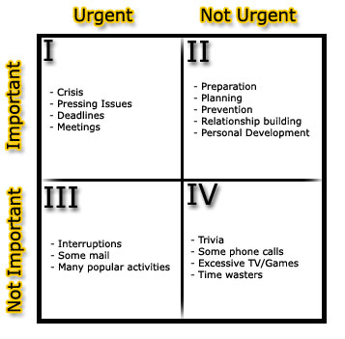
The Time Management Matrix

Slide 23
- Habit 3: Put First Things First
The Quadrant II Tool
Coherence
Balance
Focus
‘People’ Dimension
Flexibility
Portability

Slide 24
- Habit 3: Put First Things First
How to Become A Quadrant II Manager
Identifying Roles
Selecting Goals
Scheduling
Daily Adapting
Why the Fourth Generation is Better?

Slide 25
Mission Statement
Roles
Goals
LONG-TERM ORGANIZING
Roles
Goals
Plans
Schedule
Delegate
WEEKLY ORGANIZING

Slide 26
- Habit 3: Put First Things First
Delegation – Increasing P and PC
Gofer Delegation
Stewardship Delegation
Desired Results
Guidelines
Resources
Accountability
Consequences
PRODUCER
Input
Output
MANAGER
Input
Output

Slide 27
PART 1
PART 2
PART 3
PART 4
PART THREE
PUBLIC VICTORY

Slide 28
PART 1
PART 2
PART 3
PART 4
- Paradigms of Interdependence
Private Victory precedes Public Victory
The Emotional Bank Account
Six Major Deposits
Understanding the Individual
Attending to the Little Things
Keeping Commitments

Slide 29
PART 1
PART 2
PART 3
PART 4
- Paradigms of Interdependence (continued)
Six Major Deposits
Clarifying Expectations
Showing Personal Integrity
Sincere Apology on Withdrawal
Unconditional Love
P Problems – PC Opportunities

Slide 30
PART 1
PART 2
PART 3
PART 4
- Habit 4: Think Win/Win
Six Paradigms of Human Interaction
Win/Win
Win/Lose
Lose/Win
Lose/Lose
Win
Win/Win or No Deal
Which option is the best?

Slide 31
PART 1
PART 2
PART 3
PART 4
- Habit 4: Think Win/Win
Five Dimensions of Win/Win
Character
Integrity
Maturity
Abundance Mentality
Relationships
Agreements
Supportive Systems
Processes
High
Lose/Win
Win/Win
CONSIDERATION
Lose/Lose
Win/Lose
Low
Low
High
COURAGE

Slide 32
PART 1
PART 2
PART 3
PART 4
- Habit 6: Synergize
What is Synergy?
Synergistic Communication
Synergy In The Classroom
Synergy In Organizations
Synergy and Communication

Slide 33
PART 1
PART 2
PART 3
PART 4
Levels Of Communication
High
Synergistic (Win/Win)
TRUST
Respectful (Compromise)
Defensive (Win/Lose or Lose/Win)
Low
Low
COOPERATION
High

Slide 34
PART 1
PART 2
PART 3
PART 4
- Habit 6: Synergize
Negative Synergy
Valuing the differences
Force Field Analysis
All Nature is Synergistic
Restraining Forces
Driving Forces

Slide 35
PART 1
PART 2
PART 3
PART 4
PART FOUR
RENEWAL

Slide 36
PART 1
PART 2
PART 3
PART 4
- Habit 7: Sharpen The Saw
The Tale of the Saw
Four Dimensions of Renewal
Physical
Mental
Spiritual
Social/Emotional

Slide 37
PART 1
PART 2
PART 3
PART 4
The Dimensions of Renewal
PHYSICAL
Exercise, Nutrition, Stress Management
MENTAL Reading, Visualizing, Planning, Writing
SOCIAL/EMOTIONAL Service, Empathy, Intrinsic Security
SPIRITUAL Value Clarification & Commitment, Study & Meditation

Slide 38
PART 1
PART 2
PART 3
PART 4
- Habit 7: Sharpen The Saw
The Physical Dimension
Endurance, Flexibility, Strength
Regular Basis
The Spiritual Dimension
Meditation
Scriptures and Prayers
Revisiting Values
“In a flash of certainty I saw that if one’s motives are wrong, nothing can be right. It makes no difference whether you are a mailman, a hairdresser, an insurance salesman, a house wife - whatever.
As long as you feel you are serving others, you do the job well. When you are concerned only with helping yourself, you do it less well – a law as inexorable as gravity.”
Arthur Gordon

Slide 39
PART 1
PART 2
PART 3
PART 4
- Habit 7: Sharpen The Saw
The Mental Dimension
Read, Write, Question
The Social/Emotional Dimension
Communicate and Solve
Intrinsic Security
Scripting Others
Self-fulfilling Prophecies

Slide 40
PART 1
PART 2
PART 3
PART 4
- Habit 7: Sharpen The Saw
Balance in Renewal
Synergy in Renewal
Upward Spiral
Learn-Commit-Do-Learn-Commit-Do
INSIDE-OUT AGAIN
Emerson: “That which we persist in doing becomes easier – not that the nature of the task has changed, but our ability to do has increased.”

Slide 41
May ALLAH Help Us In Incorporating These Principles In Our Life. Ameen.
THANK YOU

